Slide 1

Parliamentary Procedure for General Assembly
Committees

Slide 2
Parliamentary Procedure for GA Committees
1. Foundational Principles
2. Preparing for Business
3. Handling Business
4. Subsidiary Motions
5. Privileged Motions
6. Incidental Motions

Slide 3

Part 1
Foundational Principles

Slide 4
Part 1: Foundational Principles
Foundations and Values of the General Assembly
Principles of Presbyterian Government
General Principles of Councils
Principles Underlying Parliamentary Law

Slide 5
Foundations and Values
of the General Assembly
“The General Assembly is the council of the whole church
and it is representative of the unity of the
synods, presbyteries, sessions, and congregations of the Presbyterian Church (U.S.A.)…”
(Book of Order, G-3.0501)
(continues)

Slide 6
Foundations and Values
of the General Assembly
“The General Assembly constitutes the
bond of union, community, and mission
among all its congregations and councils,
to the end that the whole church becomes
a community of faith, hope, love and witness”
(Book of Order, G-3.0501)

Slide 7
Foundations and Values
of the General Assembly
“With glad and grateful hearts, we affirm these core values,
characteristics and commitments of the General Assembly
in three areas: worship of God,
creation of community,
and faithful discernment and governance.”
The Standing Rules of The General Assembly, Part 1

Slide 8
Principles of Presbyterian Government
“Presbyters are not simply to reflect the will of the people,
but rather to seek together to
find and represent the will of Christ.”
F-3.0204, Book of Order 2005-2027

Slide 9
Principles of Presbyterian Government
“Decisions shall be reached in councils by vote,
following opportunity for discussion and discernment,
and a majority shall govern.”
F-3.0205, Book of Order 2005-2027

Slide 10
General Principles of Councils
“Meetings of councils shall be opened and closed with prayer. Meetings shall be conducted in accordance with the most recent edition of
Robert’s Rules of Order Newly Revised,
except when it is in contradiction to this Constitution.”
G-3.0105, Book of Order 2025-27

Slide 11

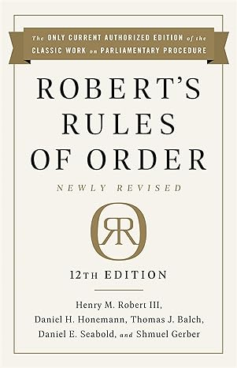
General Principles of Councils

Slide 12
Principles Underlying Parliamentary Law
“The rules of parliamentary law …
are based on a regard for the rights:
• of the majority,
• of the minority, especially a strong minority –
greater than one third,
• of individual members,
• of absentees, and
• of all these together.”
Page xlix, RONR

Slide 13
Principles Underlying Parliamentary Law
“The moderator possesses the authority necessary for
preserving order and for conducting efficiently
the business of the body.
He or she shall convene and adjourn the body
in accordance with its own action.”
G-3.0104, Book of Order 2025-2027

Slide 14
Principles Underlying Parliamentary Law
Speakers:
(usually) seek and obtain recognition before speaking and do not interrupt another speaker
address the Moderator
confine remarks to the pending question
shall not impugn another member or his/her motives
may not speak against their own motion
may not speak a second time on a motion until everyone who wishes has spoken
shall honor time limits

Slide 15
Principles Underlying Parliamentary Law
“Councils may also make use of processes of discernment
in their deliberations prior to a vote as agreed upon by the body.”
G-3.0105, Book of Order 2025-27

Slide 16
Part 2
Preparing for Business

Slide 17
General Assembly Business
The General Assembly receives the following types of business:
Overtures from presbyteries and synods
Reports from entities established by and/or responsible to the GA
Minutes from synods for general administrative review
Commissioners’ resolutions submitted by assembly commissioners

Slide 18
Committee Business
Item of Business:
Recommendations
Rationale
Advisory Committee on the Constitution (ACC) Advice
Advice and Counsel Memoranda
Comments
Financial Implications
Appendix

Slide 19
Committee Business
Hearing From Others:
Public Hearings (Standing Rules, Part 4 B.14.)
Overture Advocates (Standing Rules, Part 4, B.12.h.)
Resource Persons (Standing Rules, Part 4, B.12.i)
Financial Representatives (Standing Rules, Part 4, B. 12.j.)

Slide 20
Committee Business
Draft Agenda:
Committees meet via Zoom from June 22-June 24
Creating a community agreement/covenant
All business items referred to the committee
Hearing from others speaking to the committee
Committee deliberations & decision making
Worship & opportunity for prayer

Slide 21
Part 3
Handling Business

Slide 22
Options for Recommendation to the Assembly
Approve
with amendment and/or comment
Disapprove
with comment
Refer (to a named agency/committee)
with comment
Answer by an alternate resolution (adoption of new text)
Answer by action taken on a different item in the same committee

Slide 23
Getting to a Motion in Committee
“We will now consider item [##], [title or brief description].”
In some cases, you might be looking at more than one item at a time.
“We will first hear from [overture advocates, a representative of the committee or other group bringing the report, ACC, etc., in appropriate order]. I recognize [resource person] to speak to this recommendation.”
Resource person(s) speak when recognized.
“Thank you, _________.”
“Are there any questions?”
Depending on the circumstances, you can invite questions after all have spoken or after each speaker.
“Is there a motion?”

Slide 24
    Motion moved
    [Seconded]
    Moderator states the question
    Moderator calls for debate
    Moderator states the question
    Moderator puts the question
    Vote taken
    Moderator declares results
    Moderator explains effect
  Processing a Motion

Slide 25
Tools to Handle Some Business
Multiple similar items of business
Division of a Question (RONR 27:1-15)
Consideration by paragraph or seriatim (RONR 28:1-11)

Slide 26
Options for Discussion of Business
Quasi Committee of the Whole (RONR 52:19-23)
Informal Consideration (RONR 52:24-27)
Aids to Crystallization of Opinion (RONR 52:28)

Slide 27
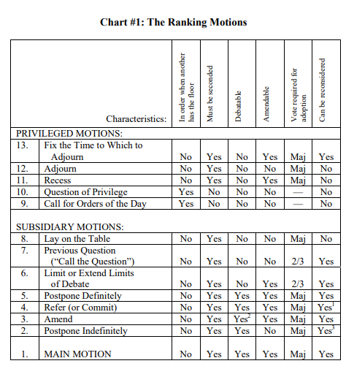

Slide 28
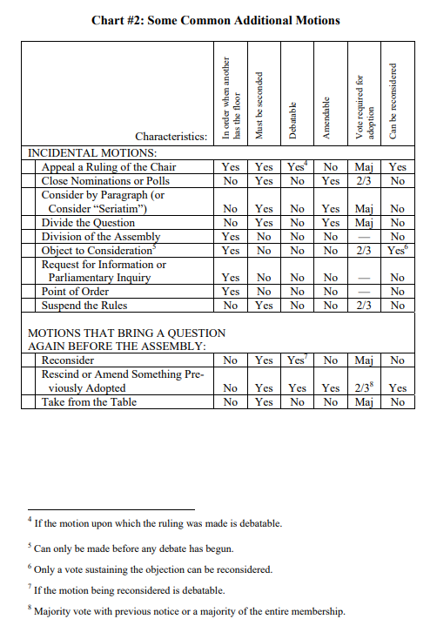

Slide 29
Part 4
Subsidiary Motions

Slide 31
Main Motion
1

Slide 32
Does it Need a Second?
Most motions require a second
– except one member alone can:
  raise a question of privilege
  call for the orders of the day
  request information or make a parliamentary inquiry
  raise a point of order
  demand division of the assembly

Slide 33
Can We Talk About It / Debate It?
Most motions may be debated – except…
  …motions that require no second
  …motions that are about how long to debate or when to meet
      limit or extend limits of debate
      move the previous question
      lay on the table
      take from the table
      recess
      adjourn
      fix the time to which to adjourn
  …motions about organizing debate and voting
      consider by paragraph – seriatim
      divide the question

Slide 34
Can We Change the Motion?
Most motions may be amended – except…
    …motions that don’t need a second
    …lay on the table or take from the table
    …call the question
    …suspend the rules
    …appeal a ruling of the chair
    …reconsider
    …adjourn

Slide 35
Primary Amendment
3.1

Slide 36
Forms of Amendment
to insert [between words] or add [at the end] – words or paragraphs
to strike out – words or paragraphs
to do both (strike out some words and insert/add others)
The words must be consecutive.

Slide 37
That all commissioners and Young Adult Advisory Delegates receive a T-shirt commemorating the 1700th anniversary of The Nicene Creed.
That all commissioners receive a T-shirt commemorating the 1700th anniversary of The Nicene Creed.

Slide 38
Secondary
Amendment
3.2
Not amendable

Slide 39
That all commissioners and Theological Student and Young Adult Advisory Delegates receive a T-shirt commemorating the 1700th anniversary of The Nicene Creed.
That all commissioners and Young Adult Advisory Delegates receive a T-shirt commemorating the 1700th anniversary of The Nicene Creed.
That all commissioners receive a T-shirt
commemorating the 1700th anniversary of The Nicene Creed.

Slide 40
Substitute Motion
A substitute motion is a motion to amend by striking out an entire paragraph, section, or article—or a complete main motion or resolution—and inserting a different paragraph or other unit in its place.
RONR 12:69

Slide 41
MAIN MOTION:
That all commissioners and Advisory Delegates receive a T-shirt commemorating the 1700th anniversary of The Nicene Creed.
SUBSTITUTE MOTION:
That everyone in attendance at the General Assembly be encouraged to celebrate the 1700th anniversary of The Nicene Creed by wearing a red T-shirt on Thursday.

Slide 42
Handling a Substitute Motion
1. Perfection of the main motion
2. Perfection of the substitute motion
3. “Shall the substitute motion become the main motion?”
--The merits of both motions can be debated
--No other amendments are in order
4. Vote on “Shall the substitute motion become the main motion?”
--In favor of the current main motion, vote no
--In favor of the substitute motion, vote yes
5. Vote on the now current main motion

Slide 43
A Word about Minority Reports
At least two members of an assembly committee may submit a written minority report expressing views that differ from those in the committee’s recommendation. If the moderators of the committee affirm that the positions expressed…were presented to the whole committee during its consideration of the matter, the Stated Clerk shall distribute it to the assembly with the report of the committee. A minority report must be appropriate for consideration as a substitute motion.
SR 4.B.16.a.

Slide 44
A Word about Voting
Majority or 2/3? Two-thirds vote often necessary to abridge the rights of members:
End debate (“Call the Question”)
Limit or extend limits of debate
Changing something that has already been decided
Suspend the rules
Rescind or amend something previously adopted
Counting the vote, doing the math
Unanimous Consent (RONR 4:58-63)

Slide 45
Unanimous Consent
A motion is made
The Moderator States, “If there is no objection…”
Pause…look around the room…give the body time….
The Moderator states, “So ordered.”

Slide 46
Postpone
Indefinitely
2

Slide 47
Commit/Refer
4

Slide 48
Postpone Definitely
5
Majority vote
(unless the time
when the motion will be taken up
creates a special order
for a particular time –
then, 2/3)

Slide 49
Limit Debate/
Extend Limits
of Debate
6
Not debatable
2/3 vote

Slide 50
Previous Question
7
Not debatable
Not amendable
2/3 vote

Slide 51
Lay on the Table
8
Not debatable
Not amendable
May not be reconsidered

Slide 52
Part 5
Privileged Motions

Slide 54
Call for the
Orders of the Day
9
Not seconded
Not debatable
Not amendable
No vote – ruled on by the moderator –
unless it is being refused, then 2/3 negative
May not be reconsidered

Slide 55
Question of Privilege
10
Not seconded –
unless requires formal action
Not debatable
Not amendable
No vote – ruled on by the moderator
May not be reconsidered

Slide 56
Recess
11
Not debatable
May not be reconsidered

Slide 57
Adjourn
12
Not debatable
Not amendable
May not be reconsidered

Slide 58
Fix the Time
to Which to Adjourn
13
Not debatable

Slide 59
Part 6
Incidental Motions

Slide 61
Point of Order
Not seconded
Not debatable –
unless the moderator submits it to the body
Not amendable
No vote – ruled on by the moderator
unless it is submitted to the body or appealed
May not be reconsidered

Slide 62
Request for Information
or Parliamentary Inquiry
Not seconded
Not debatable
Not amendable
No vote
May not be reconsidered

Slide 63
Appeal from a
Ruling of the Chair
Not amendable
Shall the decision of the moderator be sustained?
Those who support the chair vote in the affirmative,
and a majority or a tie will sustain the ruling.

Slide 64
Divide
the Question
Not debatable
May not be reconsidered

Slide 65
Consideration
by Paragraph
(Seriatim)
Not debatable
May not be reconsidered

Slide 66
Division of
the Assembly
Not seconded
Not debatable
Not amendable
No vote
May not be reconsidered

Slide 67
Reconsider
Not amendable
In committee, takes a 2/3 vote
unless there is prior notice
(or all who voted
on the prevailing side are present)
May not be reconsidered
In committee, may only be made by someone
who did not vote on the losing side.

Slide 68

Overwhelmed?

