Slide 1
Coming Alive in Christ
Training for PC(USA) Ruling Elders and Deacons Based on the Constitutional Questions
Visuals

Slide 2
Coming alive in christ
Baptism, Call, and Membership

Slide 3
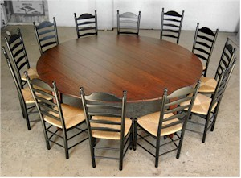
“a place where all people gather around as partners in ministry connecting to the world and each other in faith and for a life of reflection and action.”
This Photo by Unknown Author is licensed under CC BY-SA-NC
Letty Russell, The Church in the Round
Notes:
Letty Russell, a 20th century Presbyterian theologian, uses another image for the church. Her vision of the church is a round table; “a place where all people gather around as partners in ministry connecting to the world and each other in faith and for a life of reflection and action.”

Slide 4
What does a leader look like in this vision?
Leaders have authority of purpose rather than authority of position.
“Leaders with authority grounded in purpose humbly recognize that they are SERVANT LEADERS not leaders with servants.”
Letty Russell, Church in the Round

Slide 5
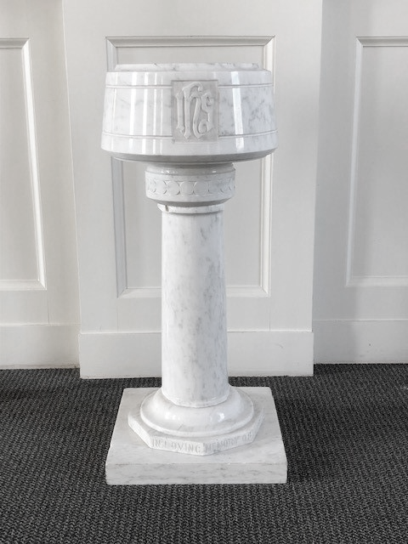
The call to servant leadership begins at our baptism
Photo by Martha H. Miller
Notes:
The call to servant leadership begins at our baptism. At baptism, we affirm that each person is a gift from God, chosen for salvation and for service, endowed by God with gifts to be used in obedience to Christ and for the building up of the Kingdom. God’s call begins before we are even aware and is nurtured by the covenant community as we grow. We grow to understand and experience God’s call through the life and worship in the community of faith.

Slide 6
How do we live out our call?
“vocation is a calling from someone to someone for some purpose.
[Vocation is about] emphasizing how we serve and give… rather than on what we receive for our labors.”
Richard M. Webster, “Considering Your Call and Vocation: Study to Enrich Inquirers and Candidates”
Notes:
How do we live out our call? Reformed theology talks about our call as our vocation. “Vocation comes from the Latin vocare meaning to call or to summon, suggesting that “vocation is a calling from someone to someone for some purpose. [Vocation is about] emphasizing how we serve and give… rather than on what we receive for our labors.”

Slide 7
WHAT IS MY VOCATION?
what are my gifts
how are they used for the common good
how are they nurtured and affirmed in community
Notes:
What is my vocation? How can I discern my call? Our vocation or our call from God can be found by identifying our gifts, asking how our gifts have been nurtured and affirmed in the body of Christ, and exploring how our gifts have been or may be used for the common good. At the intersection of these three exercises, we find our vocation.

Slide 8
In baptism God claims us,
and seals us to show that we belong to God.
God frees us from sin and death,
uniting us with Jesus Christ in his death and resurrection.
By water and the Holy Spirit,
we are made members of the church, the body of Christ,
and joined to Christ’s ministry of love, peace, and justice.
(Book of Common Worship. Louisville, KY: Westminster John Knox Press. Pg. 408.)

Slide 9
Coming alive in Christ
Do you trust in Jesus Christ your Savior, acknowledge him Lord of all and Head of the Church, and through him believe in one God, Father, Son, and Holy Spirit?

Slide 10

This Photo by Unknown Author is licensed under CC BY-NC-ND
Notes:
The Trinity Knot symbol is often found in European cathedral windows. The central ring affirms monotheism. There is one essence of God; the emphasis is on oneness, not three-ness. The Father is God, the Son is God, and the Holy Spirit is God–but they are one God. An equilateral triangle around the circle represents the equality of the three expressions of the Godhead. This symbol also conveys the idea that there are three simultaneous expressions of the divine substance. It is not that first we have God the Father, then, at a later time, God the Son, and after both of these the Holy Spirit carries the relay torch.

Slide 11
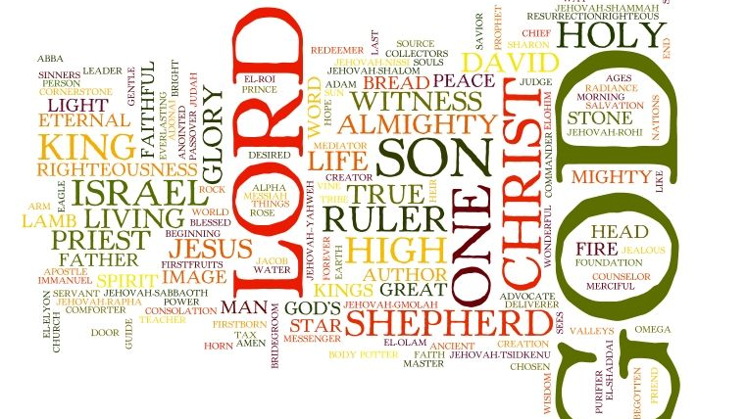
Notes:
How many names are there for God in the Bible? An internet search will reveal somewhere between 20 and 953. In this question, we find two of the most common names for Jesus—Lord and Savior—names we may often take for granted that we understand.

Slide 12
Human response
Divine action
Notes:
Salvation is a repeating cycle of God’s action and our response.
God acts with grace; we respond with gratitude. God claims us as beloved children; we proclaim God’s saving love. God redeems from sin and death; we rejoice in the gift of new life. This rhythm of Divine action and human response – found throughout scripture, human history, and everyday events – shapes all of Christian faith, life and worship. (W-1.0102)

Slide 13
Expanding our language for god
What name do you use most often for God?
Using the list of names for God, choose one that is new or unfamiliar to you.
What would it be like to use this name as you address God in prayer?

Slide 14
Coming alive in Christ
Do you accept the Scriptures of the Old and New Testaments to be, by the Holy Spirit, the unique and authoritative witness to Jesus Christ in the Church universal, and God’s Word to you?

Slide 15
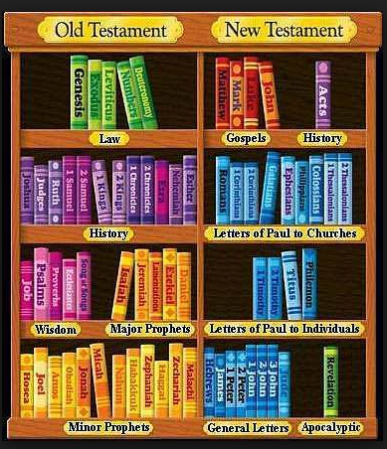
This Photo by Unknown Author is licensed under CC BY-NC-ND

Slide 16
The bible=scripture=the canon
The canon is the term used to refer to the universally accepted books of the Bible based on criteria such as…
Ancient and apostolic authorship: authored by an apostle or a close associate
Theological orthodoxy: supports a majority perspective of the faithful and consistent with other scripture
Universality: accepted by a majority of the faithful and was helpful, inspiring, and instructional, frequently read and used

Slide 17
How is the bible a unique and authoritative witness to jesus Christ?
God’s Spirit guided the ancient writers and
God’s Spirit continues to guide contemporary readers.
Notes:
What does it mean to say the Bible is the unique and authoritative witness to Jesus Christ? It means acknowledging a twofold understanding of biblical inspiration: God’s Spirit guided the ancient writers AND God’s Spirit continues to guide contemporary readers
The 123rd General Assembly (1983) of the PCUS published a statement on Presbyterian Understanding and Use of Holy Scripture that affirms the church has had a long tradition of interpreting scripture according to the ‘rule of faith’ and the ‘rule of love’ including that the witness of scripture must be consistent with the basic teaching of the church through history and the interpretation of scripture must never conflict with the commandments to love God and neighbor.

Slide 18
What is the word of god?
In the beginning was the word…..
the written word
the proclaimed word
the revealed word
Notes:
What is the Word of God? The Gospel of John uses the word logos to describe the Word of God, meaning the rational principle that gave order to the cosmos – God. For John, the logos is Jesus himself, God’s wisdom incarnated.
Theologian Karl Barth proposed the notion of the “Threefold Word of God.” Barth taught that the revealed word, the written word, and the proclaimed word are considered to be three different, yet unified forms of the Word of God. Barth compared the simultaneous independence and unity of these forms of the Word of God to the Trinity.
If we want to know God’s Word, we look to Jesus; to the Bible which provides us the best and most reliable witness to Jesus, a witness without parallel. (The Confession of 1967)

Slide 19
The one sufficient revelation of God is Jesus Christ, the Word of God incarnate, to whom the Holy Spirit bears unique and authoritative witness through the Holy Scriptures, which are received and obeyed as the word of God written. The Scriptures are not a witness among others, but the witness without parallel. …
Book of Confessions, The Confession of 1967, 9.27

Slide 20
Coming alive in Christ
Do you sincerely receive and adopt the essential tenets of the Reformed faith as expressed in the confessions of our church as authentic and reliable expositions of what Scripture leads us to believe and do, and will you be instructed and led by those confessions as you lead the people of God?

Slide 21
What is a confession?
“A confession is a public declaration of what a church believes. Individual Christians may and should confess their own personal faith, but a confession of faith is more than a personal affirmation of faith. It is an officially adopted statement of what a community of Christians believe. … Whatever their form, confessions of faith express what a body of Christians believe in common.”
“Confessional Nature of the Church Report” Book of Confessions, p. vi.

Slide 22
Essential Tenets of the Reformed Faith
Sovereignty – Election – Covenant – Stewardship – Sin - Obedience
Scripture & Justification by Grace Through Faith
Jesus Christ & the Trinity
Notes:
One of the foremost teachers on the Essential Tenets was Jack Rogers, Professor of Theology Emeritus at San Francisco Theological Seminary and Moderator of the 213th General Assembly (2001) of the PC(USA). Below is an excerpt from a blog which Rogers wrote in 2008: https://www.drjackrogers.com/2008/06/a-quick-guide-to-essential-tenets.html.
“Essentials are those doctrines that can be embraced by people of different schools of interpretation. They cannot be the property of only one school of thought. The essentials are the great themes of the Christian, Protestant, and Reformed traditions that bind us together. I believe a helpful metaphor that reflects our Presbyterian understanding of essential tenets is to think of a series of concentric circles. According to our Confessions, Jesus Christ is the center of our faith as the one in whom we meet the triune God. That is the heart of Christianity and unites Christians in faith around the world. For Protestants, the next layer of our core values is a belief in Scripture and justification by grace through faith. The third layer in the circle is made up of the characteristically Reformed concepts of sovereignty, election, covenant, stewardship, sin, and obedience.”

Slide 23
We believe that God has entrusted the church with the message of reconciliation in and through Jesus Christ; that the church is called to be the salt of the earth and the light of the world, that the church is called blessed because it is a peacemaker, that the church is witness both by word and by deed to the new heaven and the new earth in which righteousness dwells;
Book of Confessions, 10.5, The Confession of Belhar 10.5

Slide 24
Coming alive in Christ
Will you fulfill your ministry in obedience to Jesus Christ, under the authority of Scripture, and be continually guided by our confessions?
Notes:
The last two sessions focused on the role of scripture and the confessions in our discernment of our call to ministry. Those conversations led us to this ordination question, which brings together the three core principles of the Reformed faith: the centrality of Jesus Christ, the authority of scripture, and the historical witness of the confessions.

Slide 25
What does it really mean to obey Jesus Christ?
Obedience to Jesus Christ shows our willingness to get out of our own way, letting go of what we believe to be possible, right, or lawful, for a reality that God knows to be true.
Notes:
How is this different from or similar to your understanding of obedience to Jesus Christ?

Slide 26

The Confessions act as windows into our faith
This Photo by Unknown Author is licensed under CC BY-NC-ND
Notes:
The confessions act as windows into our faith: reflections of who the church believes itself to be and the injustices it has overcome to seek the kingdom of God in its life together. The past matters because in our confessions we see pieces of the church’s history and the church’s response to the contextual needs of people of faith at that time, rooted in scripture.

Slide 27
Coming alive in Christ
Will you be governed by our church’s polity, and will you abide by its discipline? Will you be a friend among your colleagues in ministry, working with them subject to the ordering of God’s Word and Spirit?
Notes:
Polity is simply the form of government of a religious denomination. The polity of the PC (USA) is based on shared leadership. Clergy do not hold the reins of power, nor do members of any ruling board within the congregation. The language of this question highlights the mutuality of ministry and governance.

Slide 28
Three types of polity
Congregational
Authority lies in the congregation
Pure democracy: 1 person-1 vote
Hierarchical
Authority lodges in individuals (bishops)
Representative
Authority is shared between laity and clergy
Representative democracy
Notes:
Congregational polity—the authority lies in the congregation—the congregation votes on all aspects of governance—each individual is granted 1 vote—Congregational and Baptist churches are examples of this form of government.
Hierarchical polity (Episcopal)—authority is lodged in individuals, usually called bishops, whose authority is specific to their level in the hierarchy—Episcopal, Lutheran, Methodist, and Roman Catholic churches are examples of this form of government
Representative (Presbyterian) —marked by shared authority—representative democracy—representatives from the congregation vote on primary aspects of governance—rooted in John Calvin’s understanding of effective governance, as practiced in Geneva—the Church of Scotland and the Presbyterian Church (U.S.A.) have this form of government

Slide 29
Session
Presbytery
Synod
General Assembly
Notes:
The structure of the councils underscores the foundation of our polity—shared leadership. Balance between clergy and laity is present at all levels. No one voice dominates over another.

Slide 30
What is the discipline of the church?
The purpose of discipline is to honor God by making clear the significance of membership in the body of Christ; to preserve the purity of the church by nourishing the individual within the life of the believing community; to achieve justice and compassion for all participants involved; to correct or restrain wrongdoing in order to bring members to repentance and restoration; to uphold the dignity of those who have been harmed by disciplinary offenses; to restore the unity of the church by removing the causes of discord and division; and to secure the just, speedy, and economical determination of proceedings.
Notes:
The fourth section of the Book of Order lays out a process for church discipline that focuses on restoration and repentance, rather than punishment.
Church discipline is always carried out by groups or councils of the church, from sessions to the General Assembly within a system of checks and balances, due process, and procedural safeguards.

Slide 31
The Church is to be a community of faith, entrusting itself to God alone, even at the risk of losing its life.
The Church is to be a community of hope, rejoicing in the sure and certain knowledge that, in Christ, God is making a new creation.
The Church is to be a community of love, where sin is forgiven, reconciliation is accomplished, and the dividing walls of hostility are torn down.
The Church is to be a community of witness, pointing beyond itself through word and work to the good news of God’s transforming grace in Christ Jesus its Lord.
F-1.0301
Notes:
How do you see this congregation embodying these words?

Slide 32
Coming alive in Christ
Will you in your own life seek to follow the Lord Jesus Christ, love your neighbors, and work for the reconciliation of the world?

Slide 33
THE CONFESSION OF BELHAR
THE CONFESSION OF 1967
ORIGIN & DATE: The Special Committee on a Brief Contemporary Statement of Faith began preparing the Confession of 1967 in 1958 as a response to the Presbytery of Amarillo's 1957 overture to the General Assembly to update the language of the Westminster Shorter Catechism
CONTEXT: The Confession of 1967 was written and debated in a denomination that found itself in an era shaped by the social movements of the 1950s and 1960s
PURPOSE: To call the church to that unity in confession and mission which is required of disciples today in the context of a desire to address modern social issues
ORIGIN & DATE: Cape Town, South Africa, in the suburb of Belhar, 1982, 1986
CONTEXT: Unjust, racist system of government in South Africa called apartheid
PURPOSE: In opposition to apartheid, to affirm the unity of the church, reconciliation between peoples, and God’s justice for the poor and destitute

Slide 34
To be reconciled to God is to be sent into the world as his reconciling community. This community, the church universal, is entrusted with God’s message of reconciliation and shares his labor of healing the enmities which separate men (and women) from God and from each other. Christ has called the church to this mission and given it the gift of the Holy Spirit. (9.31)
Therefore, the church labors for the abolition of all racial discrimination and ministers to those injured by it. Congregations, individuals, or groups of Christians who exclude, dominate, or patronize their fellow human beings, however subtly, resist the Spirit of God and bring contempt on the faith which they profess. (9.44)
Notes:
The Confession of 1967 assures us that God equips us for this important task, closing with these words from scripture: “Now to him who by the power at work within us is able to do far more abundantly than all we ask or think, to him be glory in the church and in Christ Jesus to all generations, forever and ever. Amen” (Book of Confessions, 9.56).

Slide 35
Coming alive in Christ
Do you promise to further the peace, unity, and purity of the church?
Notes:
As you begin this session, reflect on the conversations from the last session about reconciliation. Invite participants to consider how the previous ordination question and the question in this session might relate to one another and inform one another.

Slide 36
Philippians 4:2–3
I Corinthians 1:10–13a
Ephesians 4:1–6
  What characteristics does Paul seem to equate with unity in the body of believers?
  What is the role of the body in preserving unity?
  Do the passages offer any guidance as to how we as leaders can further the peace, unity, and purity of the church?

Slide 37
Saying “I do”
To working for PEACE-FILLED RELATIONSHIPS that reflect the love of Christ
To working for a CONGREGATION UNITED IN ITS MINISTRY AND MISSION
To working for a CHURCH THAT LIVES OUT ITS UNDERSTANDING OF THE FAITH as described in the PC(USA) Constitution
Notes:
This is the only ordination question that asks officers to make a promise. When you say, “I do” to this ordination question, leaders are committing to a three-fold task:
To work for peace-filled relationships that reflect the love of Christ;
To work for a congregation united in its ministry and mission;
To work for a church that lives out its understanding of the faith as described in the PC(USA) Constitution.

Slide 38
Conflict resolution begins with ME
listen
learn
love
lead
Notes:
Where 2 or 3 are gathered … there will eventually be conflict. Resolving conflict and seeking reconciliation when division happens is the role of a spiritual leader.

Slide 39
Coming alive in Christ
Will you pray for and seek to serve the people with energy, intelligence, imagination, and love?
Notes:
Discerning the Spirit of God and leading God’s people accordingly requires energy, intelligence, imagination, and love. However, our energy can be easily depleted, we can question our intelligence, our imaginations can be dampened, and our love can be tested. So, what sustains us in this work?

Slide 40
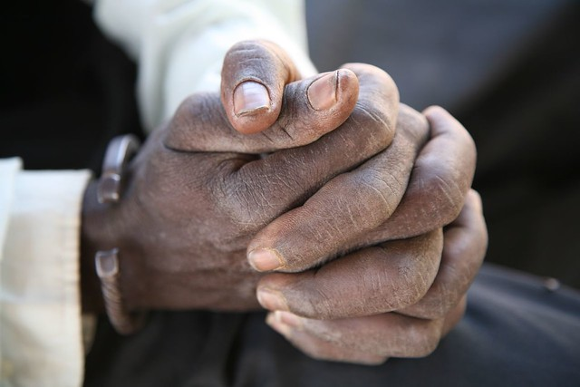
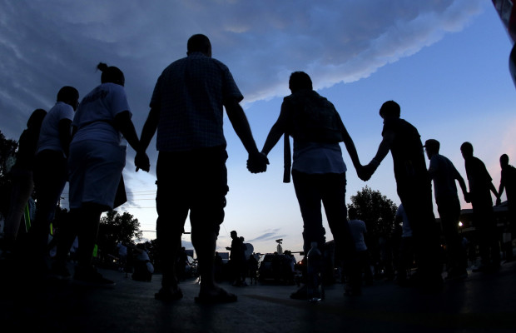
WILL YOU PRAY
This Photo by Unknown Author is licensed under CC BY-NC-ND
This Photo by Unknown Author is licensed under CC BY-NC-ND
Notes:
This ordination question begins by asking, “Will you pray for the people. Perhaps the most recognizable prayer is the Lord’s Prayer. In that example of prayer, attributed to Jesus in the Gospel of Matthew and Luke, we find these words: “When you pray. …” Prayer is what we do; a natural and enduring expression of the human hope that life makes sense. Prayer is a human inclination to express our need, our joy, our desires, our pain to God. Prayer is an attitude, a lifestyle of orientation toward God. Prayer is both individual and corporate; an act of obedience to God and an act of solidarity with the community of faith. John Calvin defined prayer as “none other than an expanding of our hearts in the presence of God.”

Slide 41
energy
intelligence
WILL YOU SERVE WITH
Notes:
CLICK ON THE SLIDE THEN CLICK AGAIN FOR EACH WORD

Slide 42
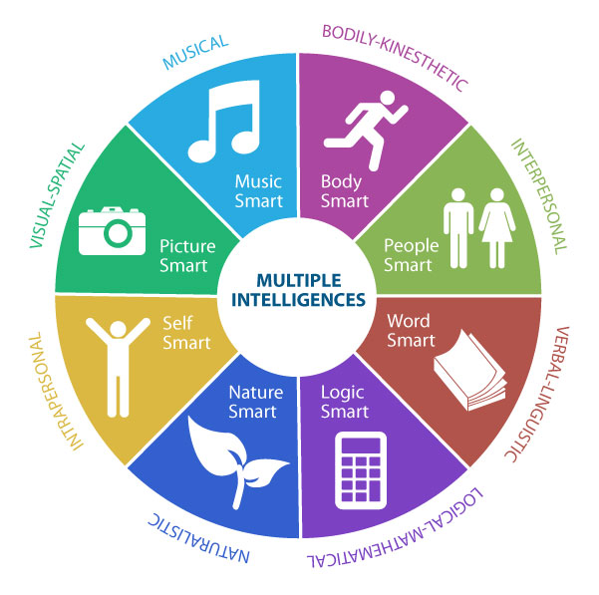
This Photo by Unknown Author is licensed under CC BY
Notes:
As Presbyterians, we are deeply invested in the rigor of intellectual thought. There are, however, different kinds of intelligence. Howard Gardner, a professor of education at Harvard University and developmental psychologist, outlined nine types of intelligence. Each way of knowing contributes to our corporate knowledge. “There are many gifts, but the same Spirit.”

Slide 43
energy
intelligence
WILL YOU SERVE WITH
imagination
love
Notes:
CLICK ON THE SLIDE THEN CLICK AGAIN FOR EACH WORD

Slide 44
Coming alive in Christ
Will you be a faithful ruling elder, watching over the people, providing for their worship, nurture, and service? Will you share in government and discipline, serving in councils of the church, and in your ministry will you try to show the love and justice of Jesus Christ?
Notes:
There are four specific tasks of ruling elders highlighted by this question:
Be faithful in your role as shepherd to the people.
2. Provide for the worship, nurture, and service of the people.
Share in responsibilities of government and discipline, serving in councils of the church.
Show the love and justice of Jesus Christ.

Slide 45
Remember……
You were elected to this position because you have demonstrated wisdom, maturity of faith, leadership, and compassion in spirit.
The call to serve as a ruling elder is a call to shared ministry.
Ruling elders and ministers of Word and Sacrament participate equally.

Slide 46
Providing for their WORSHIP
Authorize
Sacraments
Ongoing Christian formation
Use of church property
Oversee
Evangelism
Order of worship with minister of Word & Sacrament
Educational programs for officers and members
Provide
Opportunity for those seeking membership to explore faith, examine and receive new members
Cultivate
The ability to teach
Select
Hymnals, service books, Bibles and other permanent worship resources (in concurrence with others)
Educate
About the church’s worship and provide for study of the Directory of Worship

Slide 47
And let the peace of Christ rule in your hearts, to which indeed you were called in the one body. And be thankful. Let the word of Christ dwell in you richly; teach and admonish one another in all wisdom; and with gratitude in your hearts sing psalms, hymns, and spiritual songs to God. And whatever you do, in word or deed, do everything in the name of the Lord Jesus, giving thanks to God the Father through him. [Col. 3:12–17]
As God’s chosen ones, holy and beloved, clothe yourselves with compassion, kindness, humility, meekness, and patience. Bear with one another and, if anyone has a complaint against another, forgive each other; just as the Lord has forgiven you, so you also must forgive. Above all, clothe yourselves with love, which binds everything together in perfect harmony.

Slide 48
Coming alive in Christ
Will you be a faithful deacon, teaching charity, urging concern, and directing the people’s help to the friendless and those in need, and in your ministry will you try to show the love and justice of Jesus Christ?
Notes:
There are five specific tasks of deacons highlighted by this question:
Be faithful in your role as servant among the people
Teach charity
Urge concern
Direct people’s energy and help toward those in need
Show the love and justice of Jesus Christ

Slide 49
Faithfulness
Teaching Charity
Urging Concern
Directing help to those in need
Showing the love and justice of Jesus Christ
Notes:
Faithfulness - The commitment to serve as a deacon is a commitment to keep ministries of compassion alive in the midst of challenges and resistance. Faithfulness also requires a commitment to care for our spiritual lives, so we can continue to care for others.
Teaching charity - The word “charity” simply means “love of persons,” which differs from “toxic charity” that conveys pity, negative stereotypes.
Urging concern—Concern is showing love to those within the congregation and for those beyond the congregation.
Directing help to those in need. This task requires deacons to be attentive to the actual needs of the community and of the congregation and to match needs with the resources of the congregation.
Showing the love and justice of Jesus Christ as reflected in Mark 2:1–12 and 8:1–9 and in the Book of Order, G-2.0201

Slide 50
And let the peace of Christ rule in your hearts, to which indeed you were called in the one body. And be thankful. Let the word of Christ dwell in you richly; teach and admonish one another in all wisdom; and with gratitude in your hearts sing psalms, hymns, and spiritual songs to God. And whatever you do, in word or deed, do everything in the name of the Lord Jesus, giving thanks to God the Father through him. [Col. 3:12–17]
As God’s chosen ones, holy and beloved, clothe yourselves with compassion, kindness, humility, meekness, and patience. Bear with one another and, if anyone has a complaint against another, forgive each other; just as the Lord has forgiven you, so you also must forgive. Above all, clothe yourselves with love, which binds everything together in perfect harmony.

